Slide 1
Game: I Am Here As Well
A presentation by:
Huub van Holsteijn | HyeonWoo Jeong | JeongUm Lee
Arturo Iván Sandoval Rodríguez | Jeongmin Park | Liam Voyle
Notes:
Introduce everyone to the users

Slide 2
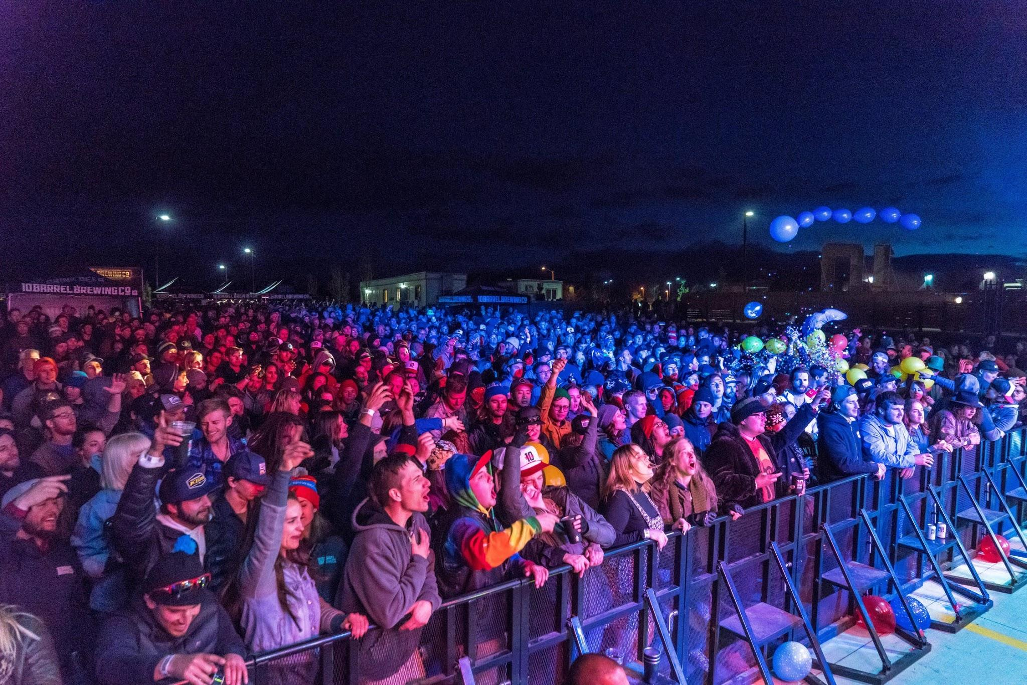

Slide 3
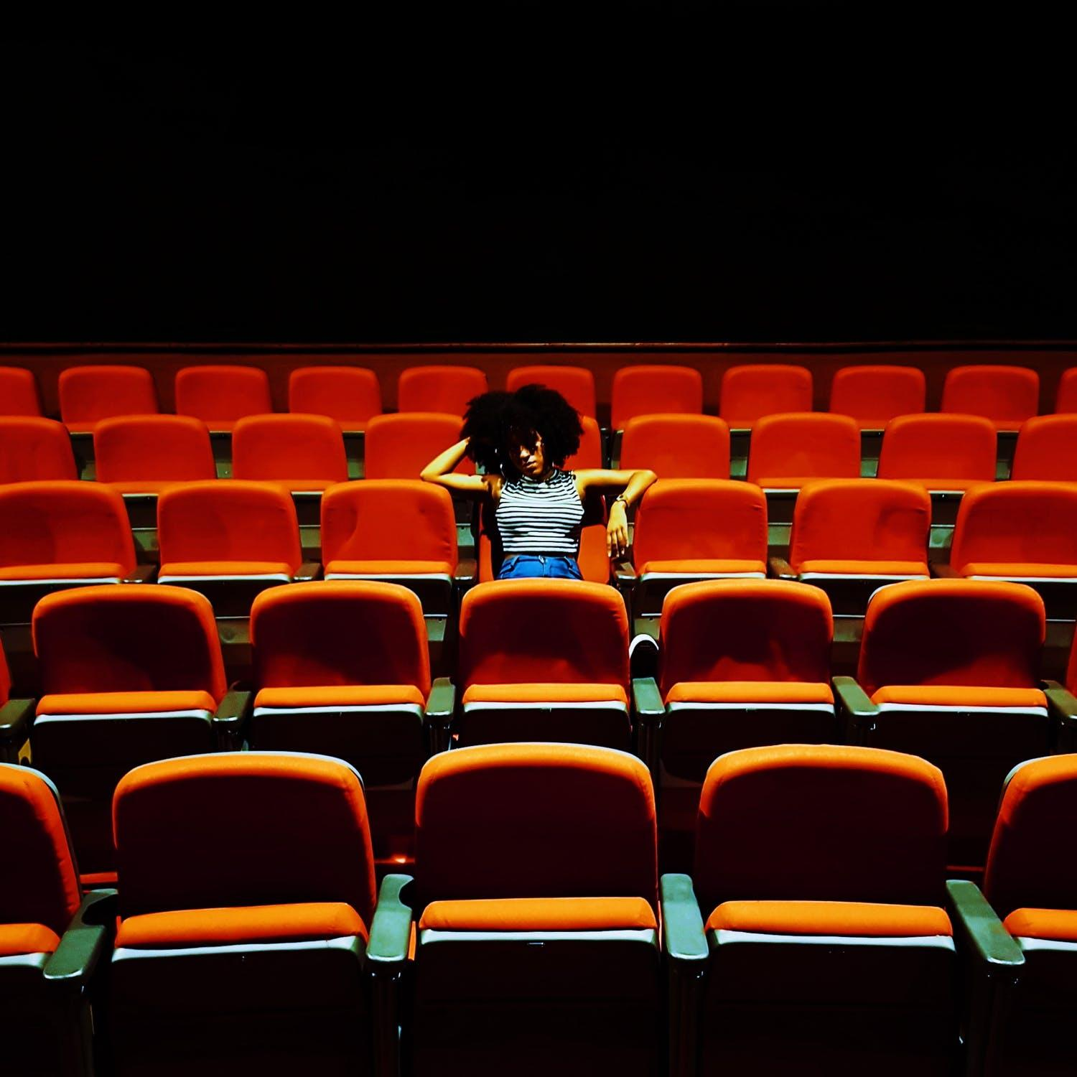

Slide 4
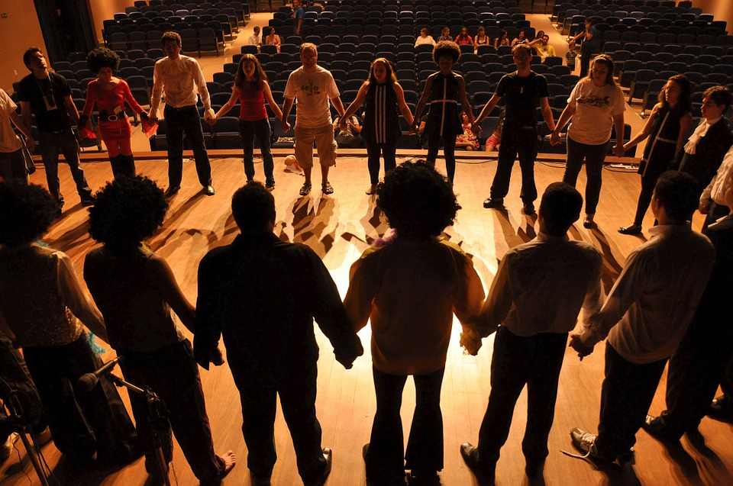

Slide 5
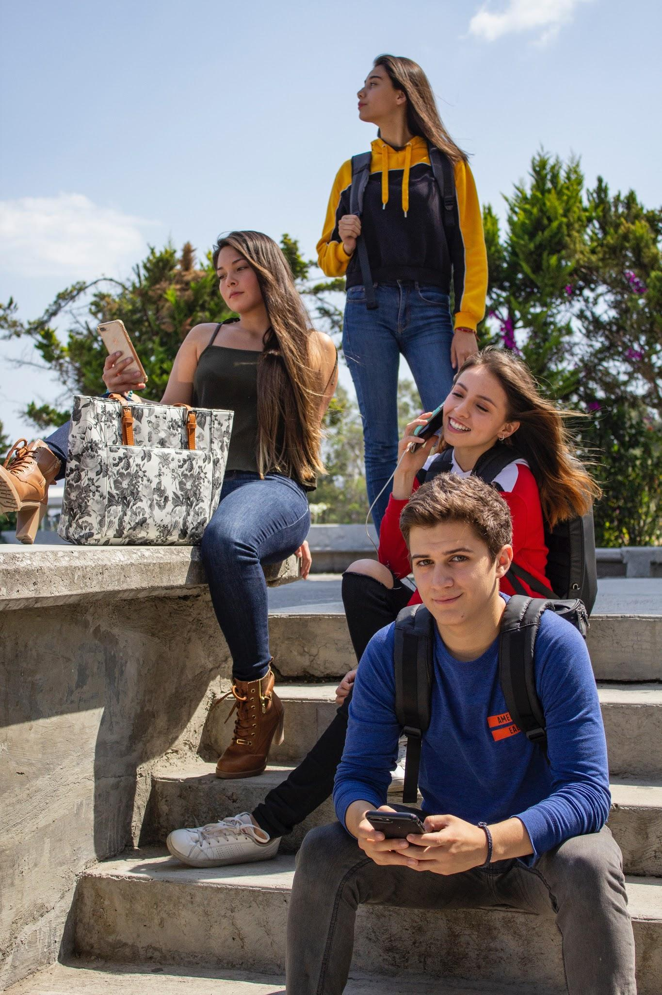
Target Audience

Slide 6

Aim
Inform
Educate
Gamification

Slide 7

Product
Description
Cross platform
Web based
2D Layout
Pixel style
Story driven

Slide 8

Story

Slide 9

Phaser

Slide 10


Webpack

Slide 11

Amazon Web Services
Notes:
It had a yearly free subscription after registering a credit card.
Fastest to implement for the team.

Slide 12

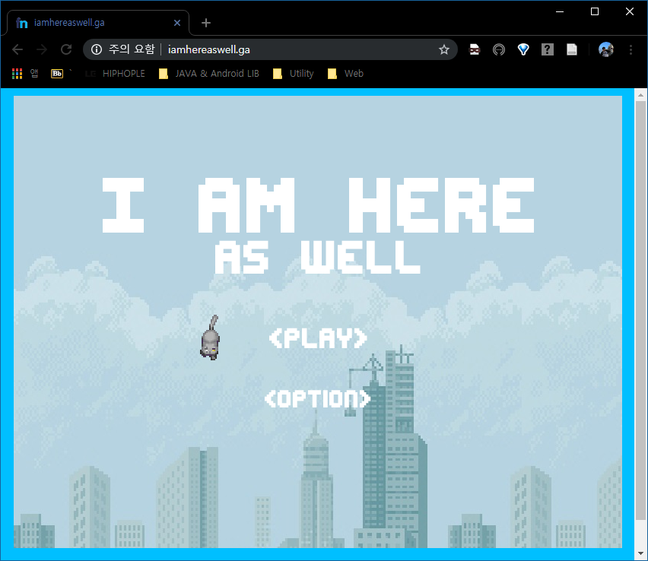
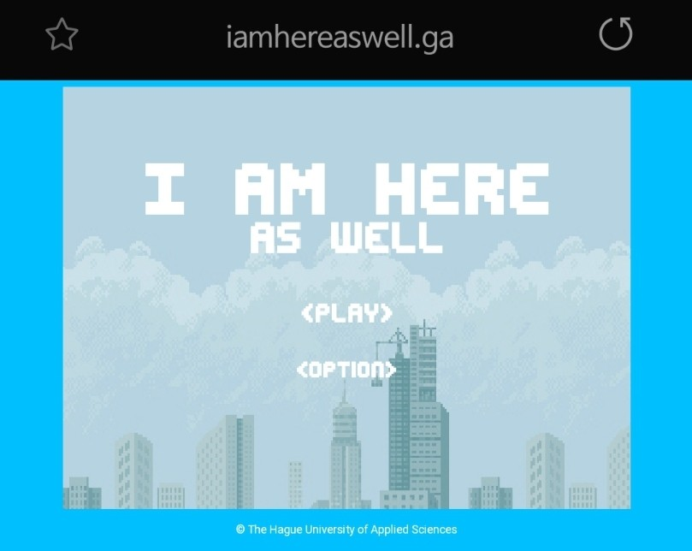
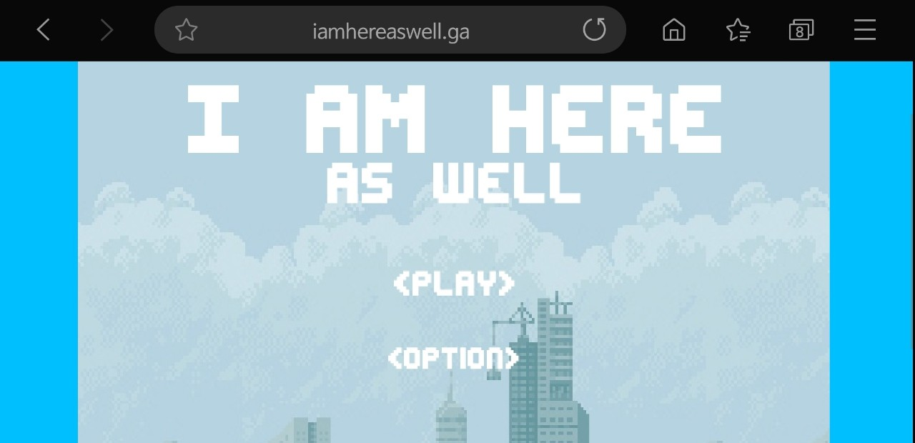
Notes:
The most important thing is we can play the game wherever with any electronic devices, if the internet is accessible

Slide 13
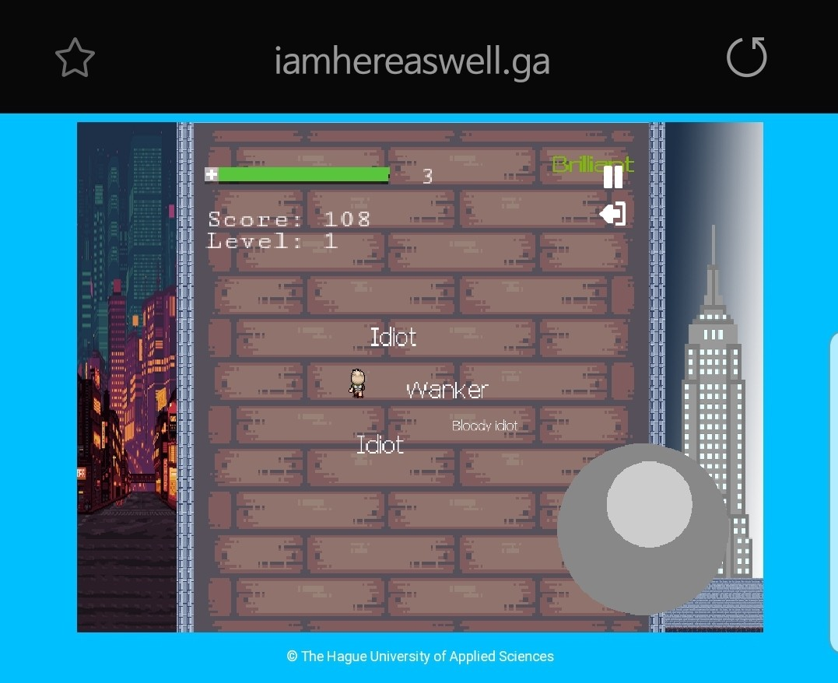
Notes:
The most important thing is we can play the game wherever with any electronic devices, if the internet is accessible

Slide 14
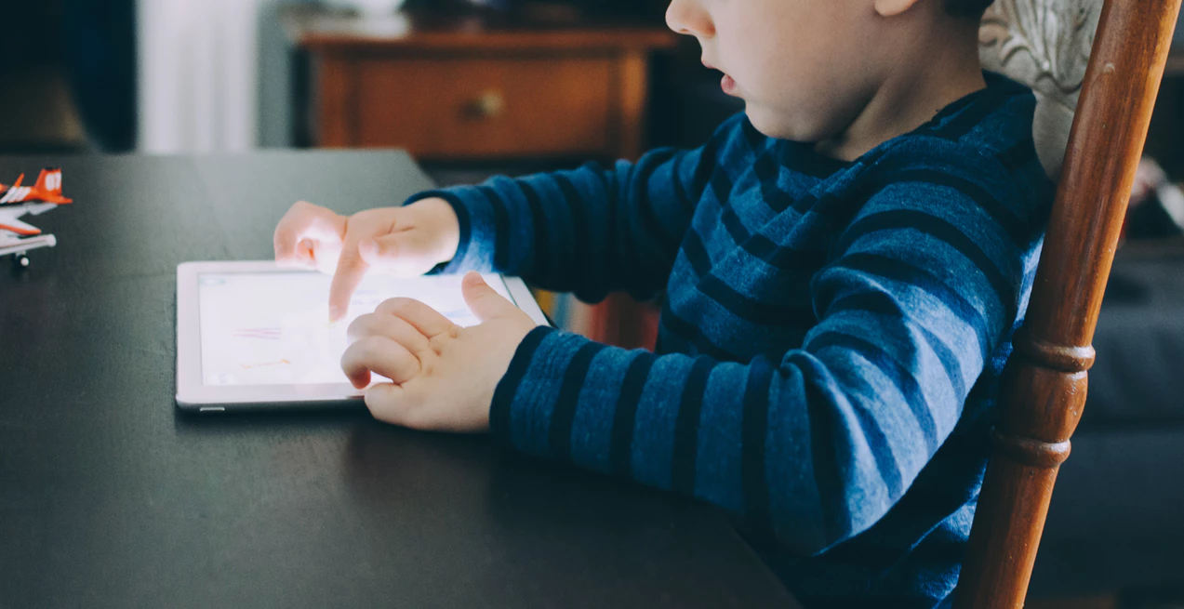
User testing
Notes:
Whenever you test a new product you are like a child finding everything works on a new world
Just like this kid behind me
As testers exploring our game

Slide 15
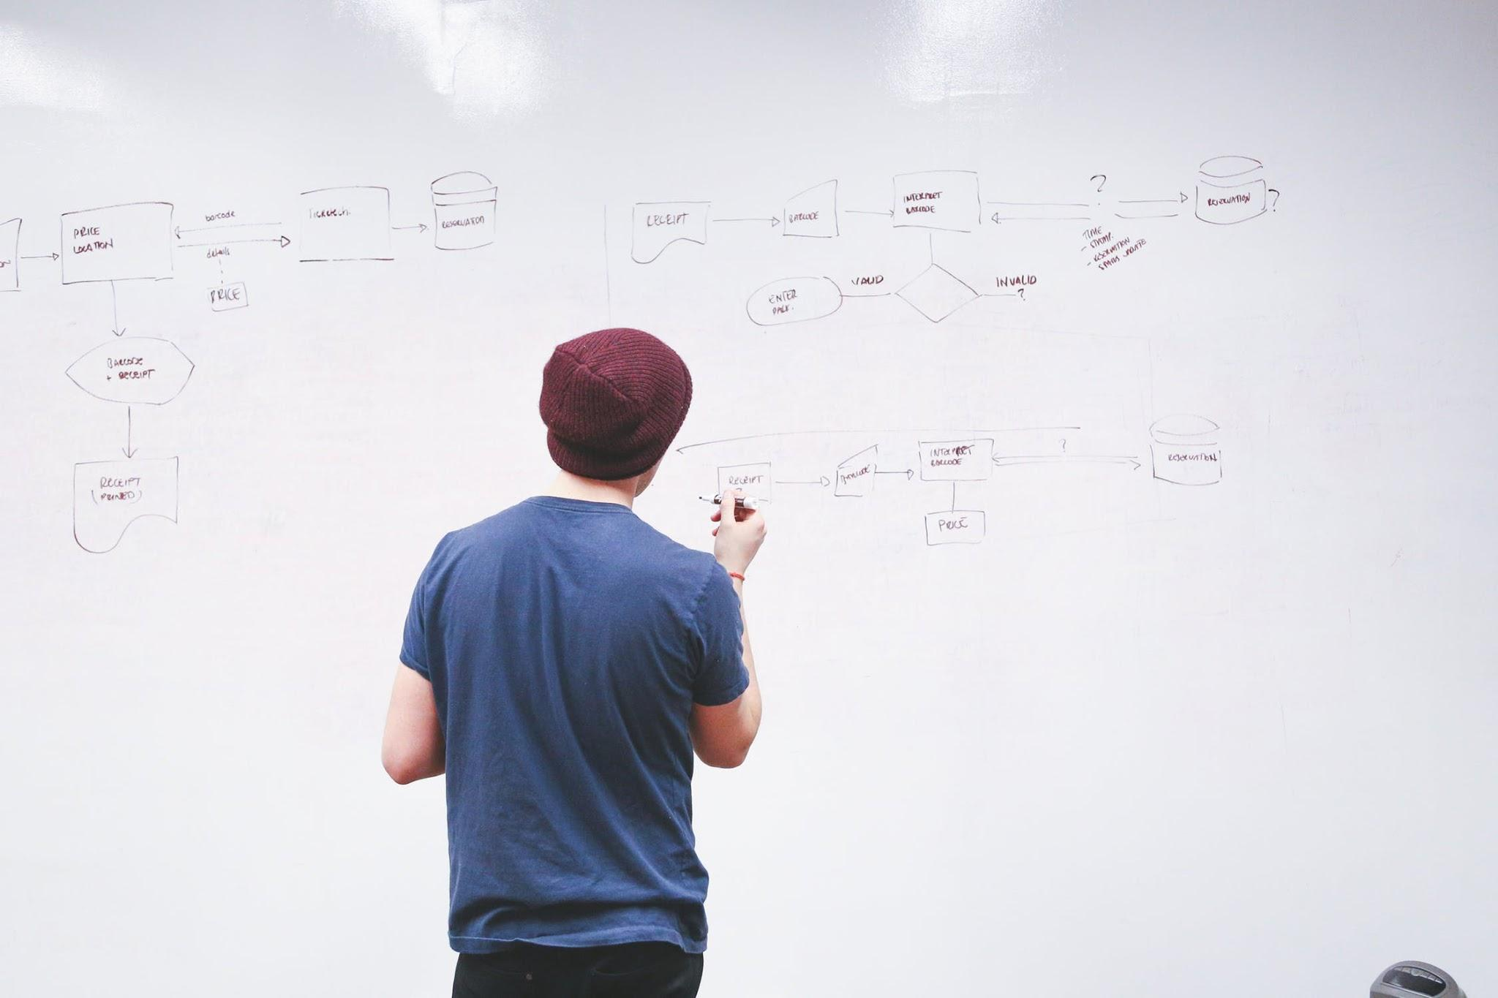
Process
Notes:
First I will to you how to dress a scrum process

Slide 16
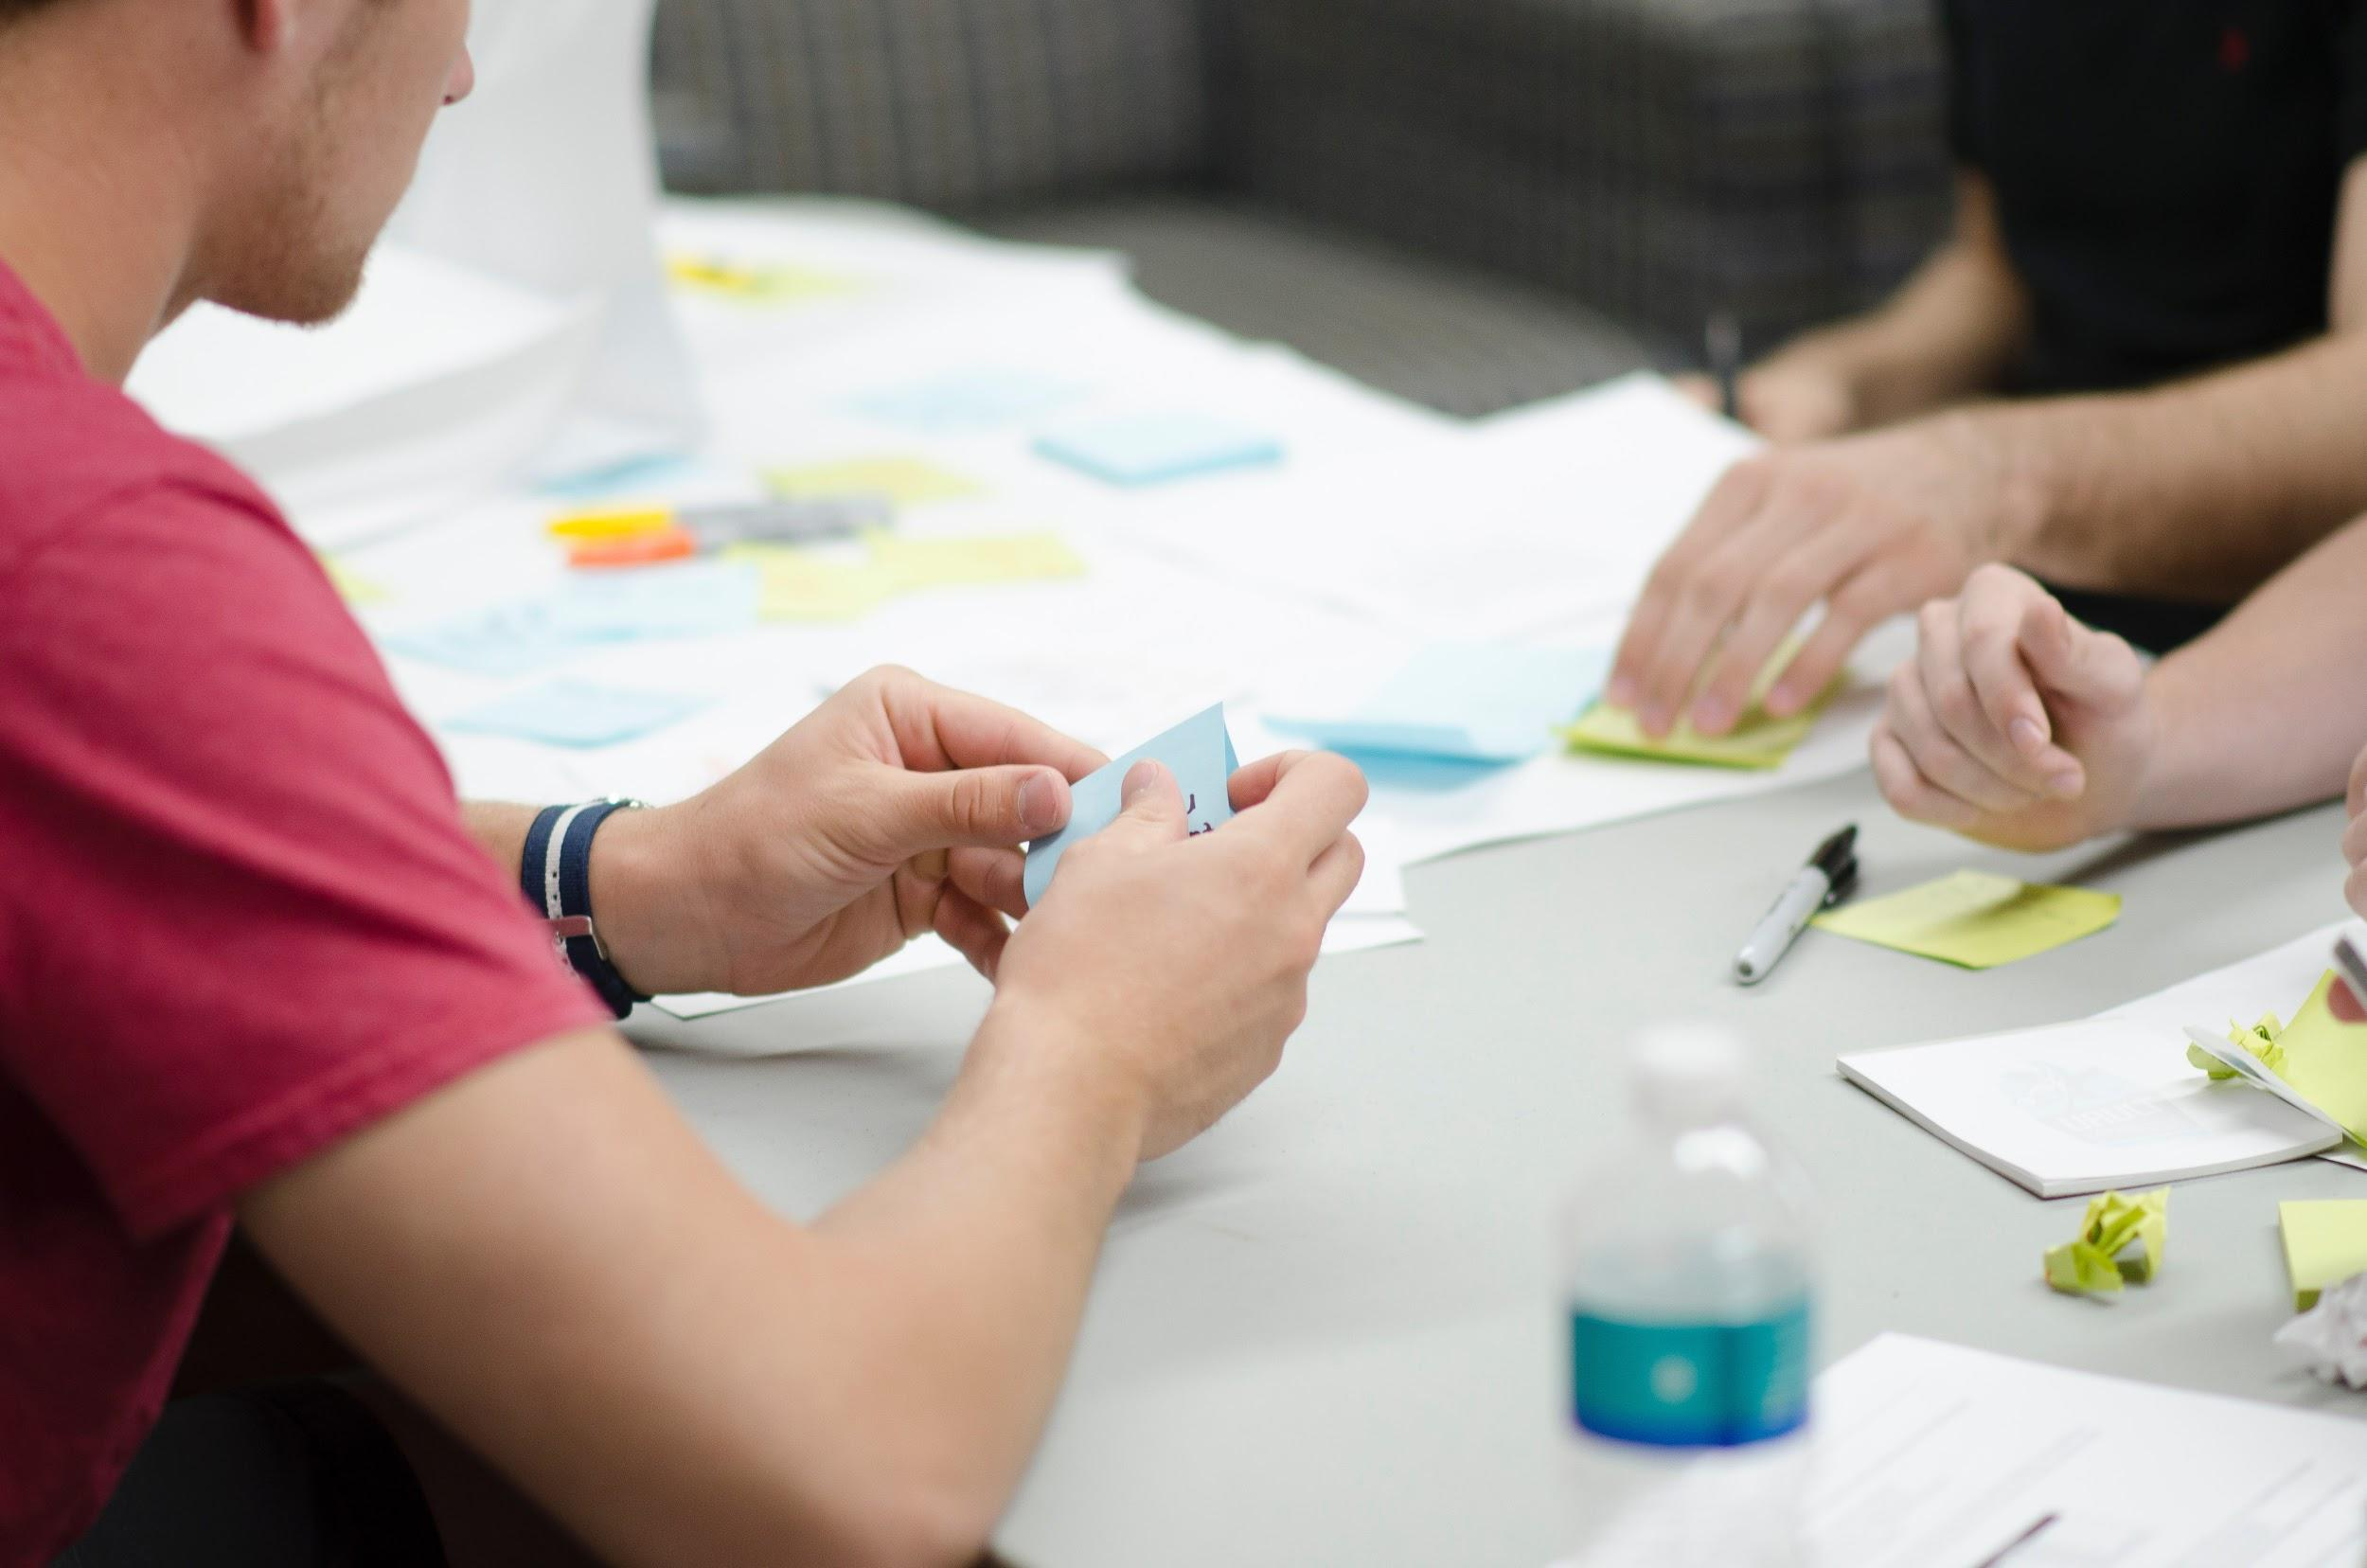
Scrum
Meeting the client demands
Setting goals
Planning poker
Notes:
Shoes
Meeting the client demands getting the requirements
Trousers
Setting goals
By naming every sprint
Shirt
Planning poker
A game where giving points to a requirement is necessary

Slide 17
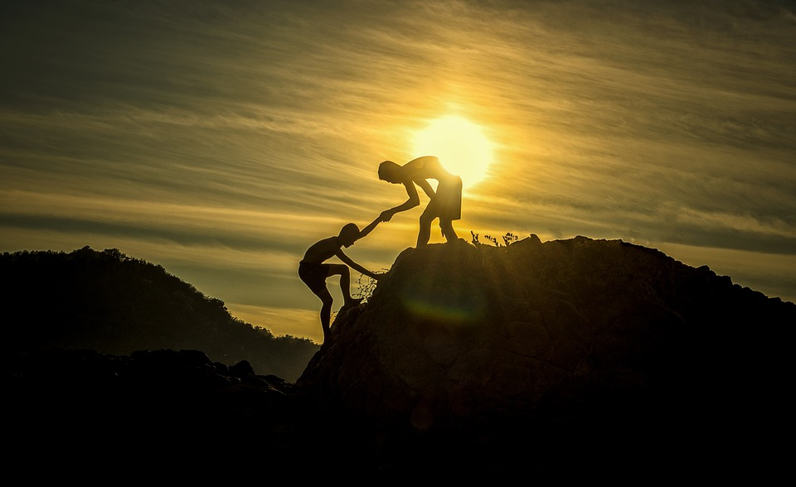
Challenges
Notes:
Feedback
Work ethic
Time
Vacations

Slide 18


Work challenges
Dividing the work
Feedback
Time

Slide 19

Visual design
Notes:
Style
Images
Royalty free
Color

Slide 20
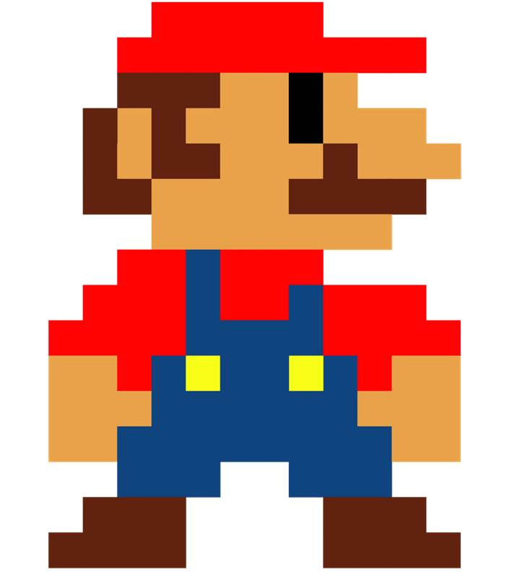
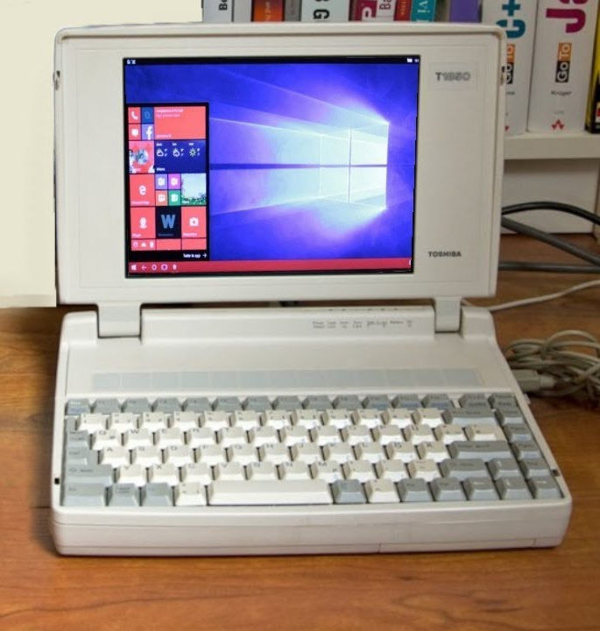
Two dimensional (2D) compared to Three dimensional (3d)
Pixel style
Old computer With Windows 10
Notes:
First 2 vs 3d
Width & Height
Width & Height and depth
Pixel style
A 2D style since it only exists out of squares.
(Ask if everyone in the back can see the picture clearly).
Low color count, so that difference can bee seen more easily
Old computers
add more process power since the third dimension needs to be calculated.

Slide 21

Colours
Contrast
Light and dark
Dark topic
Notes:
Dark color
Contrast
Difference between light and dark, generally it is the colored opponent of
Since our game had a dark topic, it would have been weird to use light colours. Because it would create a happy place where nobody is being bullied, which is not in our case.

Slide 22

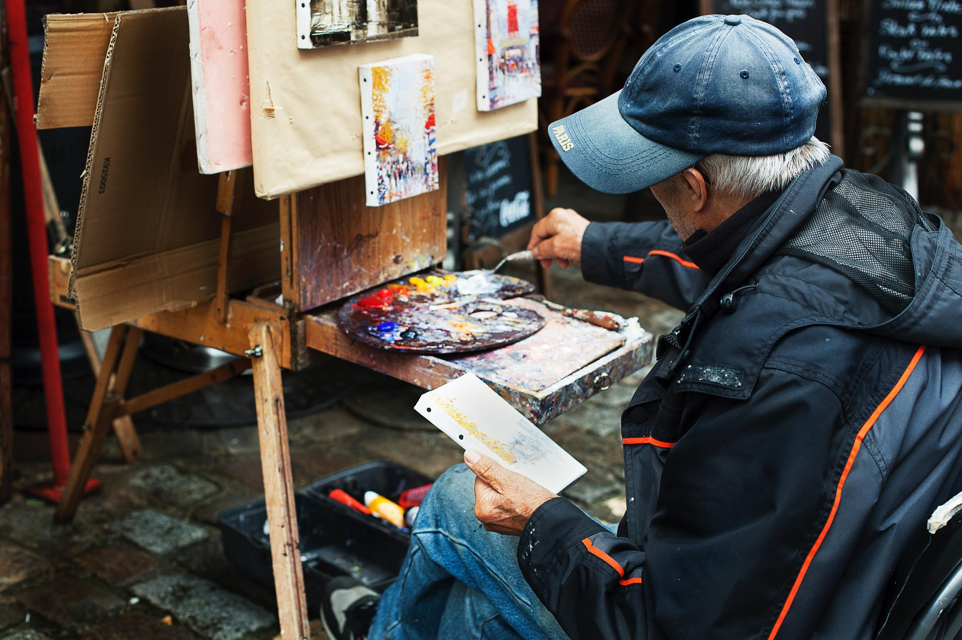

Royalties
Product creator or Licence keeper
Licensing free
No compensation
Location
Asking creators
Online
Notes:
Royalty free images
Licensing free
No payment for use
Owned by a productor creator or license keeper
Compensation since not everything is live is free
Location
Asking creators their design assets ( For example ask Liam for a design asset)
Digital age also found online

Slide 23
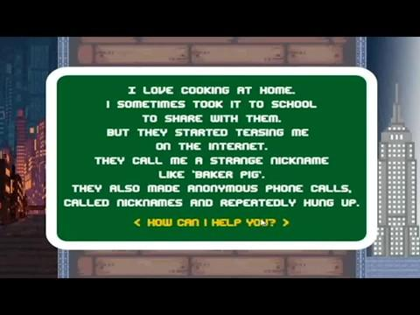
Video time

Slide 24
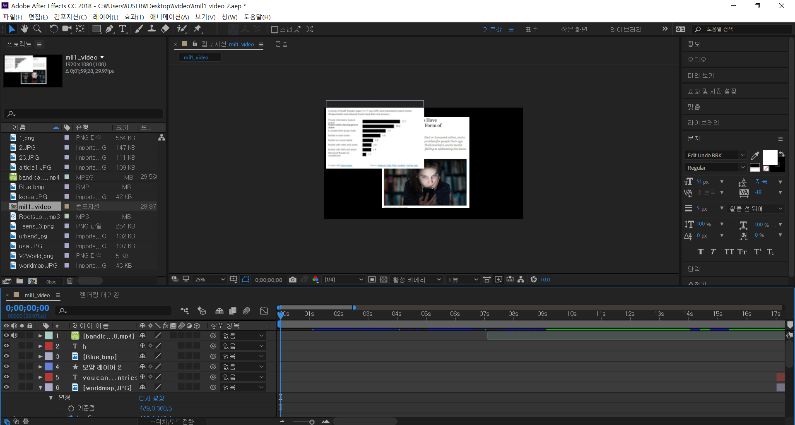
Explanation trailer

Slide 25
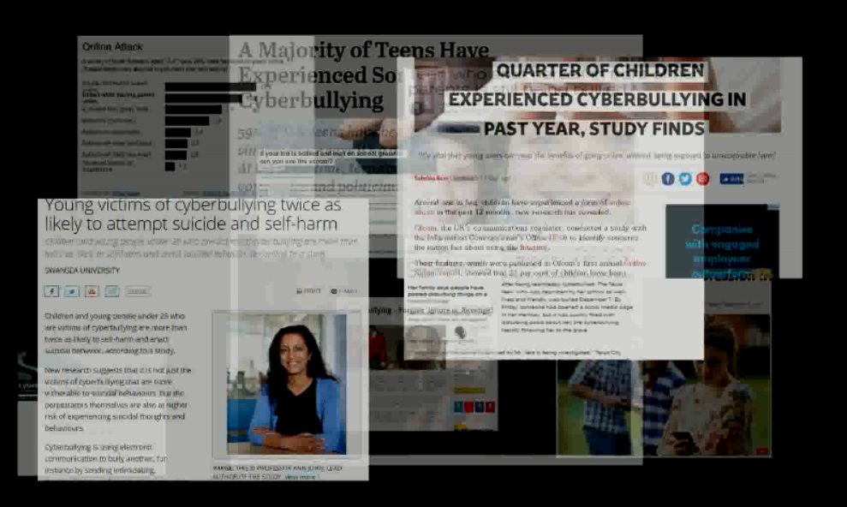
Explanation trailer

Slide 26
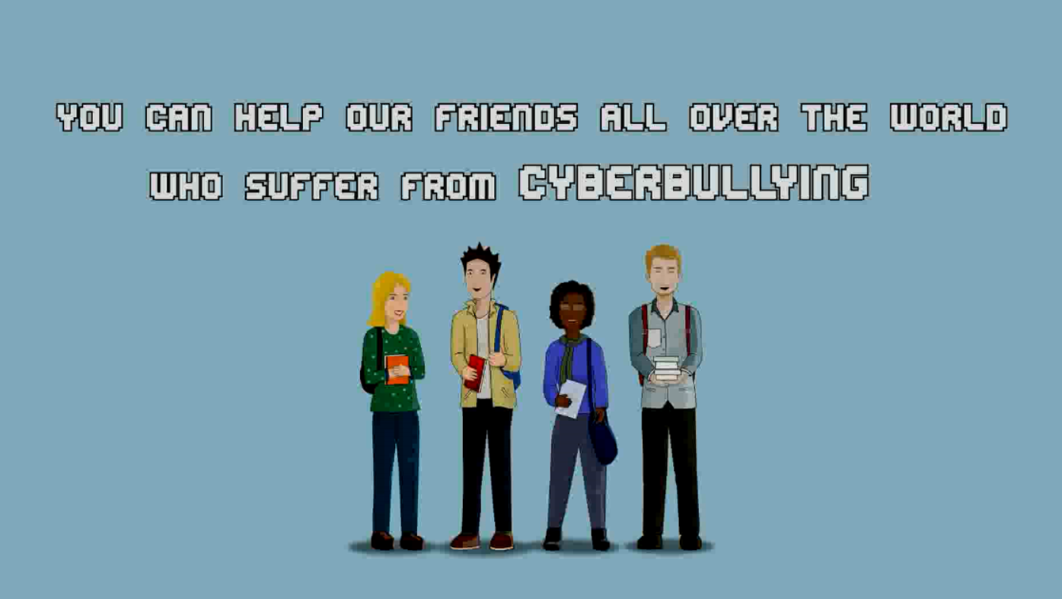
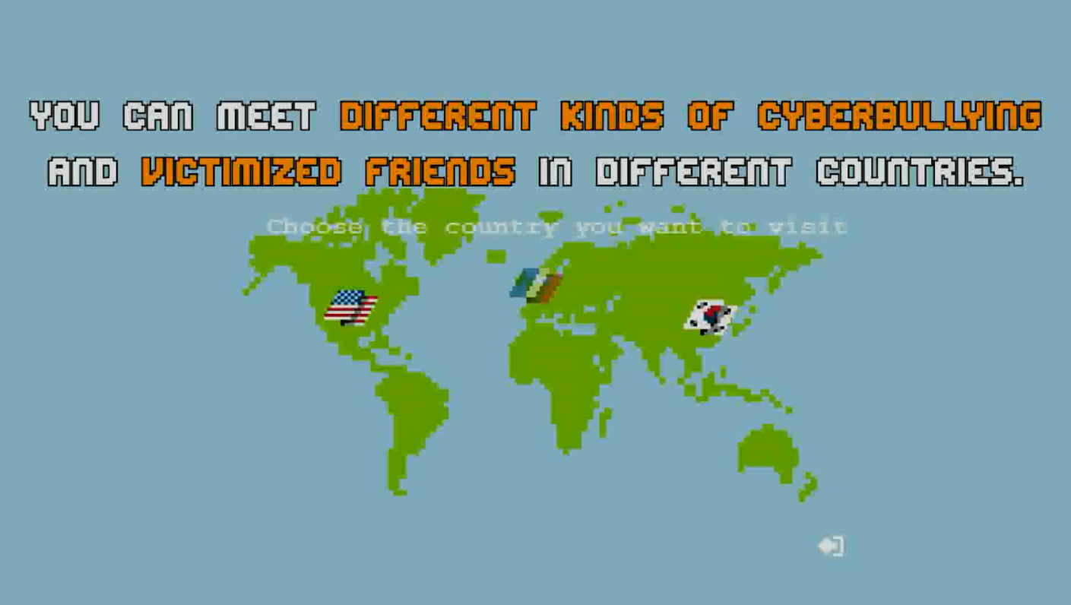
Explanation trailer

Slide 27
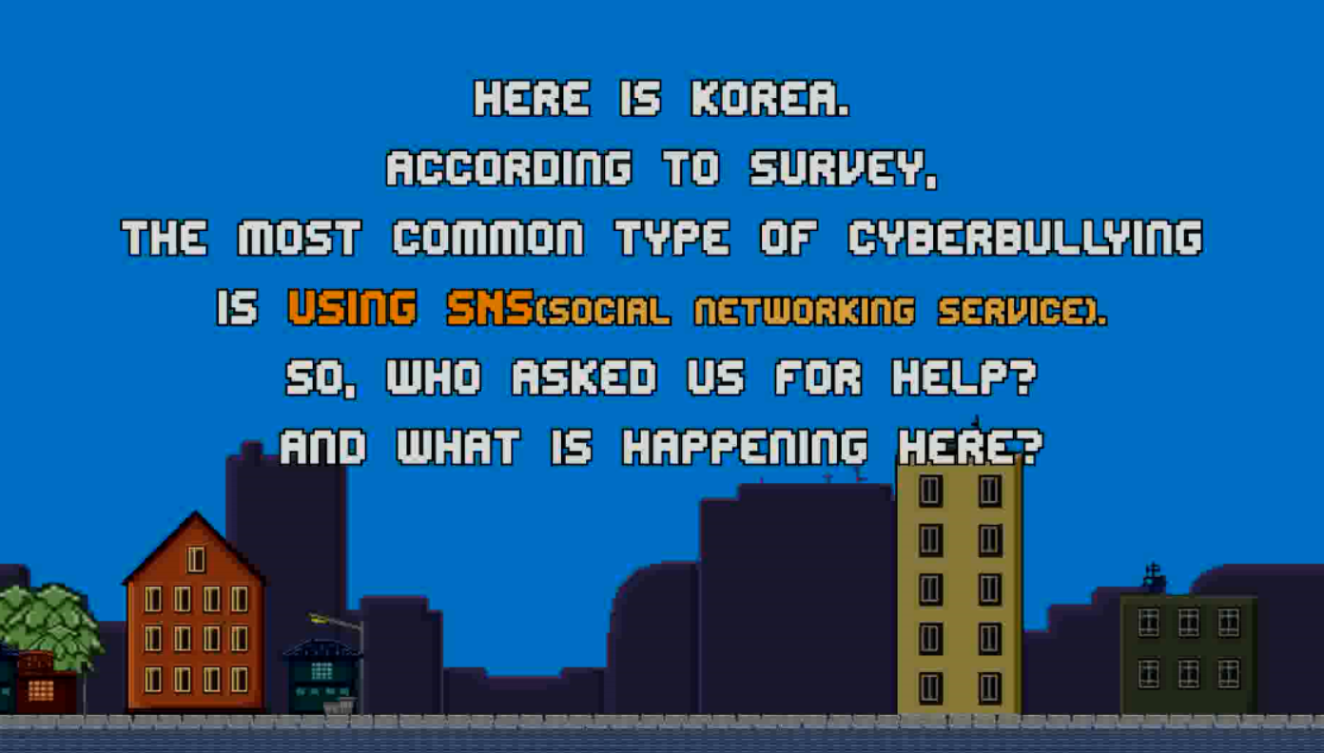
Explanation trailer

Slide 28
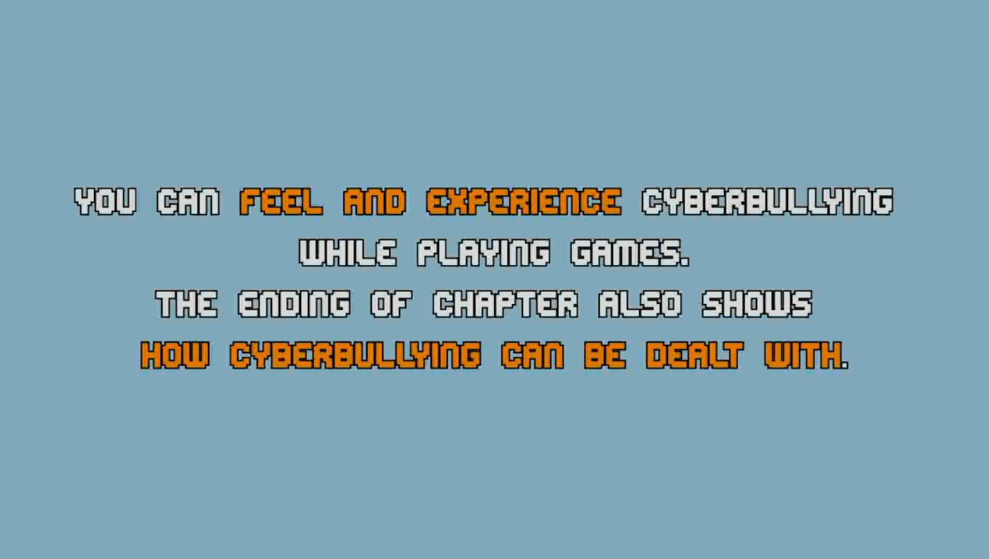
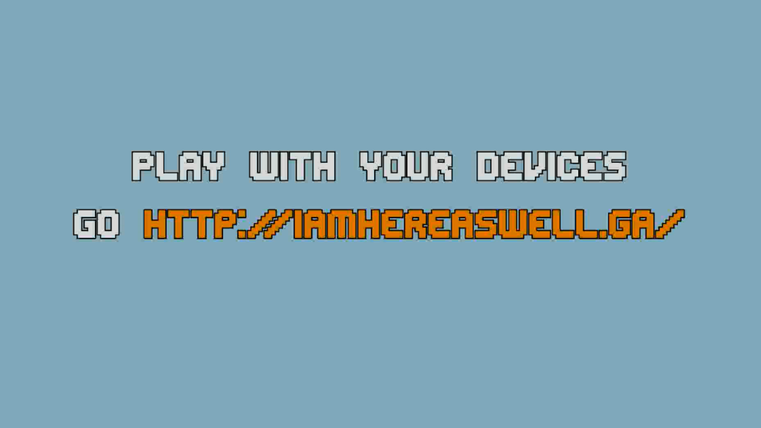
Explanation trailer

Slide 29

Only together cyberbullying can be prevented
Notes:
Play I Am Here As Well
I
It is the greatest game of all time. So start playing at http://iamhereaswell.ga or http://iamhereaswell.tk/

Slide 30
So if you want to learn more about cyberbullying around the world go to:
http://iamhereaswell.ga

Slide 31

Questions?

Slide 32
Bibliography
Holsteijn, H. van, Jeong, H. W., Lee, J., Sandoval Rodríguez, A. I., Park, J., & Voyle, L. (2019). I Am Here As Well. 32.

